Slide 1
BB2950 Day 25: Friday 12-8-17
Learning objectives:
List some of the points at which gene expression can be regulated.
Describe or diagram typical gene structures for prokaryotes and eukaryotes.
Distinguish between different types of transcription factors.
Explain the ways in which transcriptional activators and repressors control expression.

Slide 2
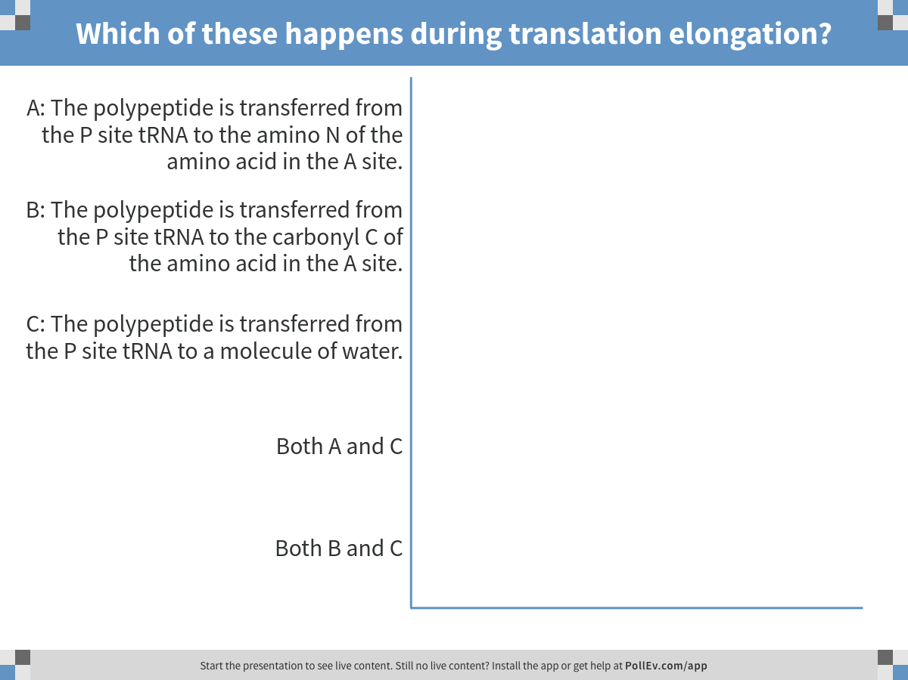
Correct answer: A
Notes:
Which of these happens during translation elongation?
https://www.polleverywhere.com/multiple_choice_polls/iOpfF3DTZMT17Uz

Slide 3
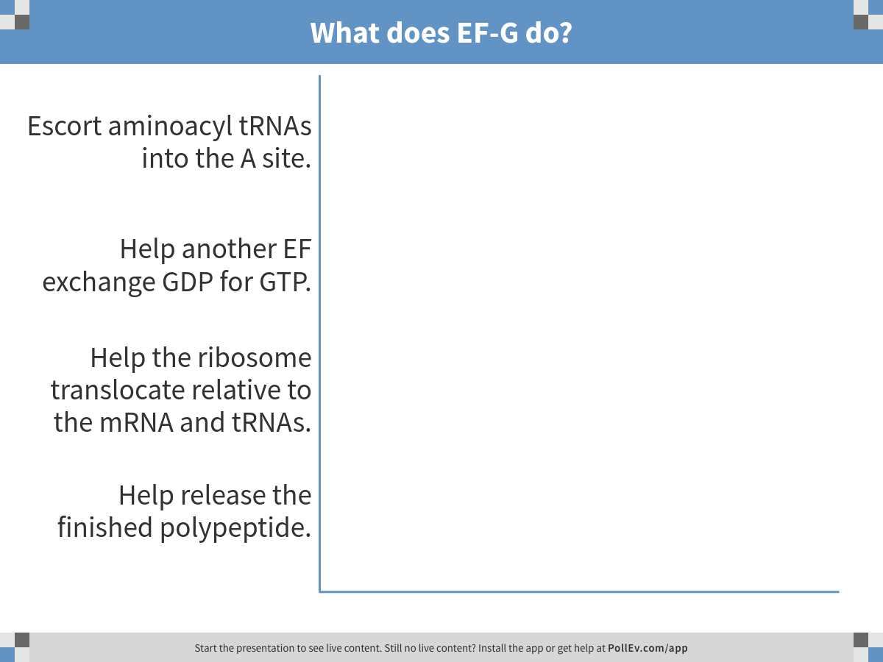
Notes:
What does EF-G do?
https://www.polleverywhere.com/multiple_choice_polls/QlgFwrTCcZXzidu

Slide 4
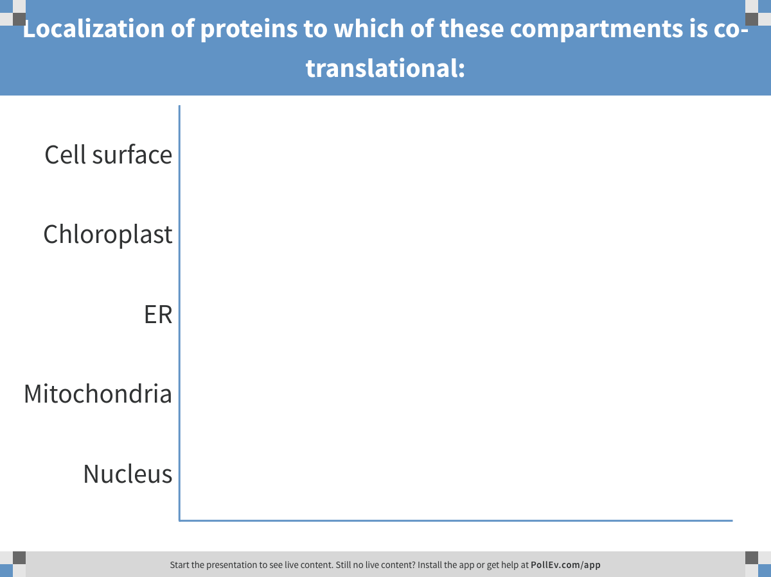
Notes:
Localization of proteins to which of these compartments is co-translational:
https://www.polleverywhere.com/multiple_choice_polls/4TrZ5lMTUSxBYwQ

Slide 5
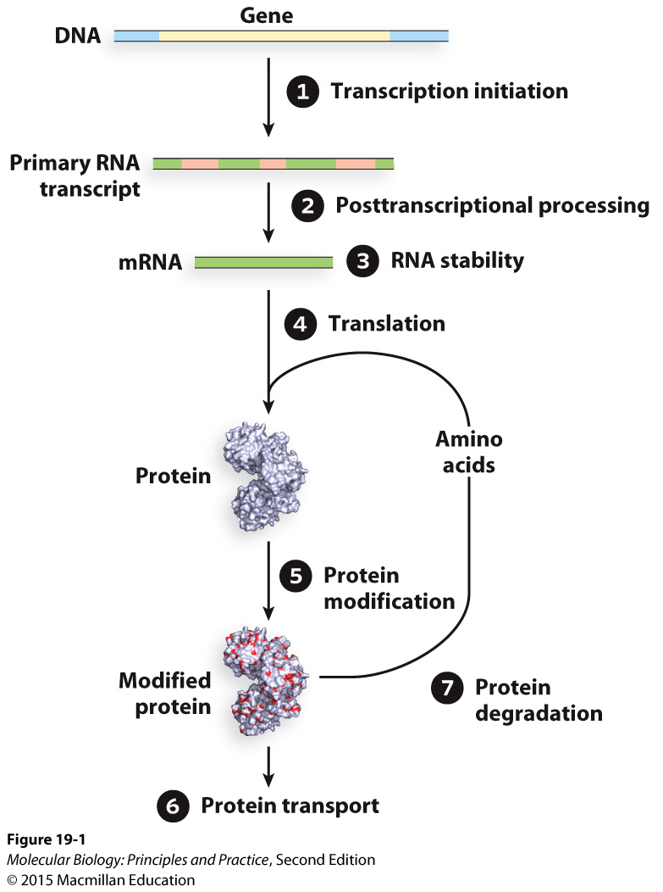
Gene expression can be regulated at many levels

Slide 6
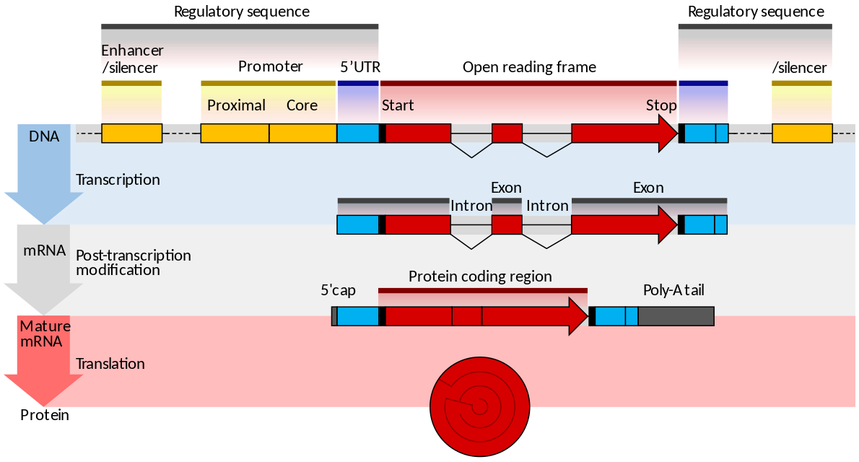
Eukaryotic gene structure
Image credit: Thomas Shafee via wikimedia commons
Notes:
Add label for 3’ UTR

Slide 7
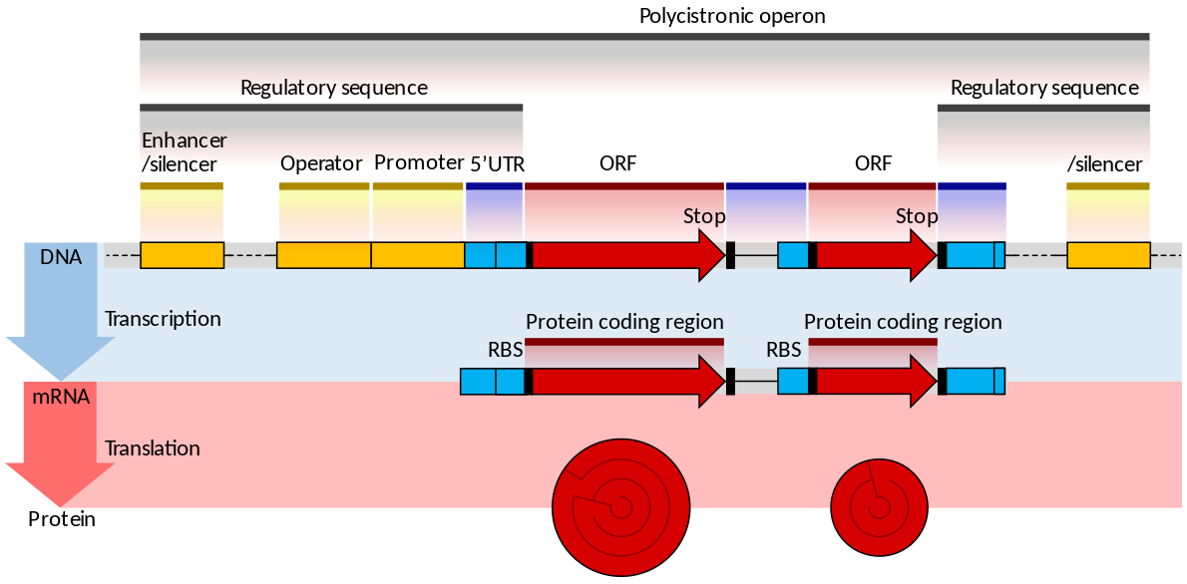
Prokaryotic gene structure
Image credit: Thomas Shafee via wikimedia commons
Notes:
Add label for 3’ UTR
Note that not all prokaryotic genes are in polycistrons

Slide 8
Transcription factors:

Slide 9
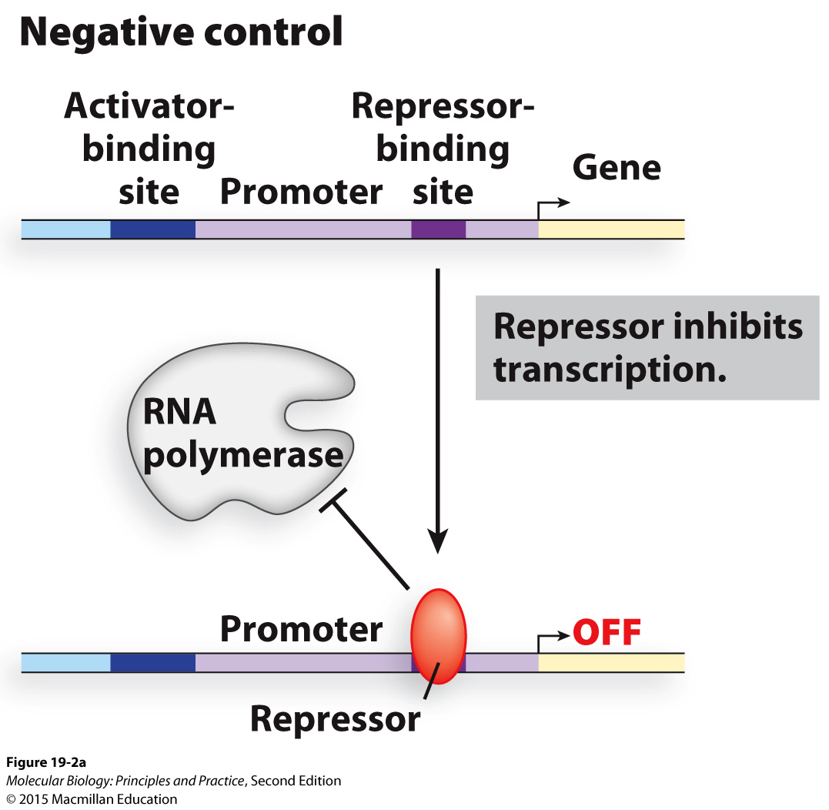
Repressors often block binding of RNA Pol or general TFs, or inhibit RNA Pol allosterically

Slide 10
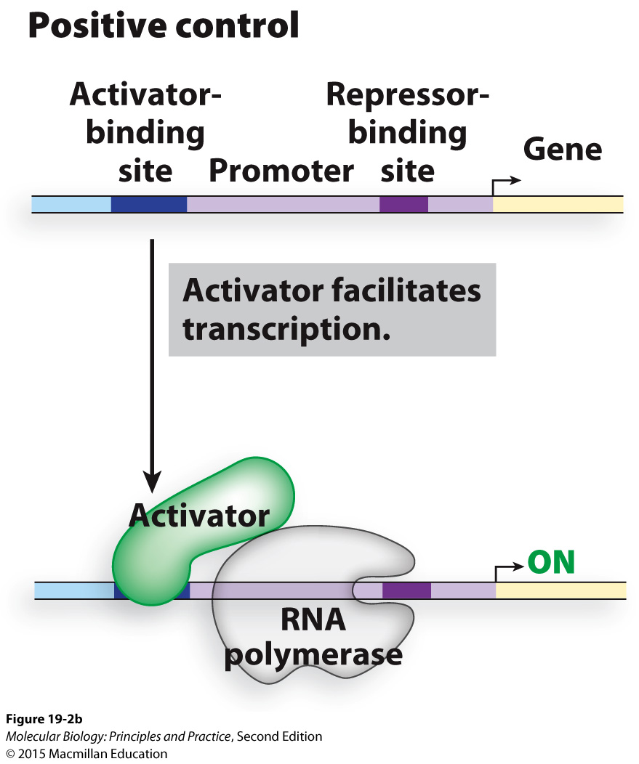
Activators often increase the affinity of RNA Pol for DNA, or activate RNA Pol allosterically

Slide 11
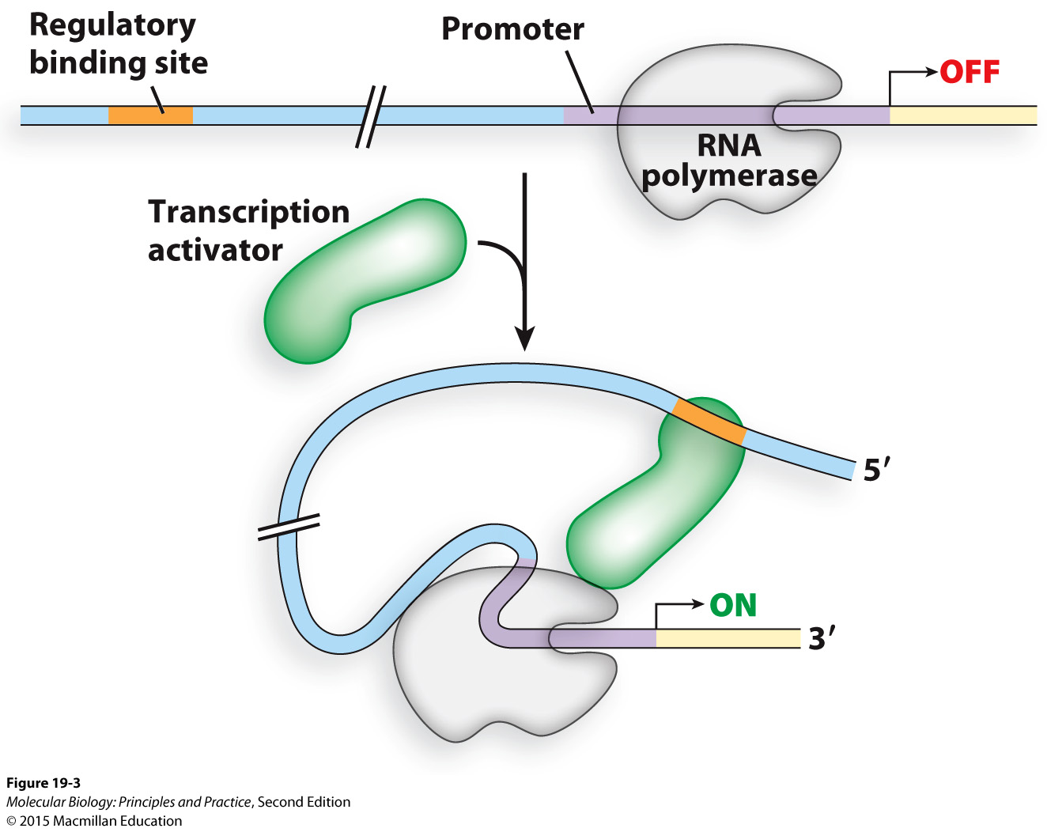
Transcription factors may bind far upstream

